Slide 1
Title
Project by:
Name of group members
Supervised by:
Bharati Vidyapeeth’s College of Engineering, New Delhi

Slide 2
Motivation for the work

Slide 3
Introduction

Slide 4
Related Work
Ref. No. |  |  |  |  | Comments
[7]
[27]
[28]
[30]

Slide 5
Methodology
Simulation of device design
Extraction of I-V Characteristics
Comparison of results
Device design optimization
Device Design

Slide 6
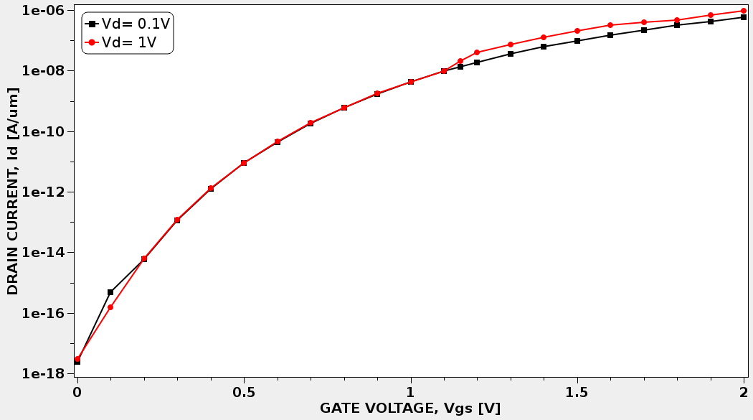
Results
Fig. 13 Drain Induced Barrier Lowering effects studied at V_{DS} = 1 V and V_{DS} =0.1V

Slide 7
Conclusion

Slide 8
References
[1] L. Esaki, “New Phenomenon in Narrow Germanium p-n Junctions,” Phys. Rev. Lett., vol. 109, no. 2, pp. 0–1, 1958.
[2] Arthur Beiser, Concepts of Modern Physics, Sixth. McGraw-Hill Companies,Inc., 2003.
[3] T. Baba, “Proposal for Surface Tunnel Transistors,” Jpn. J. Appl. Phys., vol. 31, no. Part 2, No. 4B, pp. L455–L457, Apr. 1992.
[4] C. Duvvury, “A guide to short-channel effects in MOSFETs,” IEEE Circuits Devices Mag., vol. 2, no. 6, pp. 6–10, Nov. 1986.
[5] K. K. Bhuwalka, J. Schulze, and I. Eisele, “Scaling the Vertical Tunnel FET With Tunnel Bandgap Modulation and Gate Workfunction Engineering,” IEEE Trans. Electron Devices, vol. 52, no. 5, pp. 909–917, May 2005.
[6] K. K. Bhuwalka, S. Sedlmaier, A. K. Ludsteck, C. Tolksdorf, J. Schulze, and I. Eisele, “Vertical Tunnel Field-Effect Transistor,” IEEE Trans. Electron Devices, vol. 51, no. 2, pp. 279–282, Feb. 2004.
[7] K. Boucart and A. M. Ionescu, “Double-Gate Tunnel FET With High-k Gate Dielectric,” IEEE Trans. Electron Devices, vol. 54, no. 7, pp. 1725–1733, Jul. 2007.
[8] “International Technology Roadmap for Semiconductors 2.0,” 2015.
[9] J. Appenzeller, Y.-M. Lin, J. Knoch, and P. Avouris, “Band-to-Band Tunneling in Carbon Nanotube Field-Effect Transistors,” Phys. Rev. Lett., vol. 93, no. 19, p. 196805, Nov. 2004.
[10] K. K. Bhuwalka, M. Born, M. Schindler, and I. Eisele, “Scaling Rules for Tunnel Field-Effect Transistors,” in 2005 International Semiconductor Device Research Symposium, 2005, pp. 13–14.
[11] M. Born et al., “Tunnel FET: A CMOS Device for high Temperature Applications,” in 2006 25th International Conference on Microelectronics, 2006, no. Miel, pp. 124–127.
[12] K. K. Bhuwalka, M. Born, M. Schindler, M. Schmidt, T. Sulima, and I. Eisele, “P-Channel Tunnel Field-Effect Transistors down to Sub-50 nm Channel Lengths,” Jpn. J. Appl. Phys., vol. 45, no. 4B, pp. 3106–3109, Apr. 2006.

Slide 9
Thank you.

